Slide 1

Note: The data and information in this document is reflective of a hypothetical situation and client. This document is to be used for KPMG Virtual Internship purposes only.
Sprocket Central Pty Ltd
Data analytics approach

Slide 2
Note: The data and information in this document is reflective of a hypothetical situation and client. This document is to be used for KPMG Virtual Internship purposes only.
Overview and Structure
Introduction
Data Exploration
Model Development
Interpretation

Slide 3
Note: The data and information in this document is reflective of a hypothetical situation and client. This document is to be used for KPMG Virtual Internship purposes only.
Introduction
Introduction
Analyse the Data and recommend Potential Customers.
Aims and Objective:
To study, explore and analyse the data.
To visualise the data in a meaningful way.
Determine ways to boost the sales of Spyrocket Central Pty Ltd.
Aim to know the Potential Customers that increase the sales.
Data Analysis Approach:
Age Distribution of Customers to maximum profit.
Order Distribution by Wealth Segment.
Distribution of Order by State, Gender.
Distribution of Order by Job industry and Job Title.
Gender vs Owns a Car.
State vs Owns a Car.
Order and Profit Distribution by Wealth Segment.
RFM(Recency Frequency Monetary) Analysis.

Slide 4
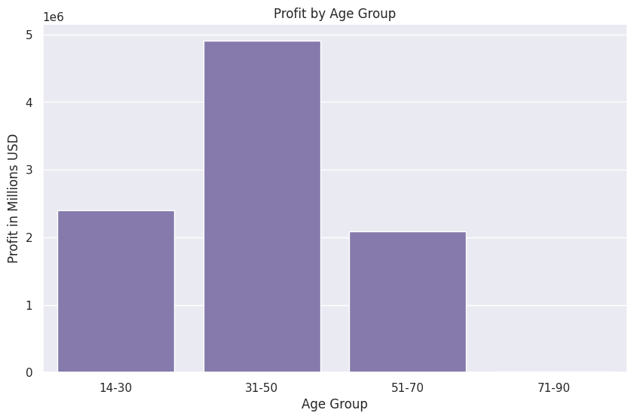
Note: The data and information in this document is reflective of a hypothetical situation and client. This document is to be used for KPMG Virtual Internship purposes only.
Data Exploration
Customers Age Distribution to maximum profit
The customers in the Age Group 31-50 gives the maximum profit. This Age group should be targeted.
Place any supporting images, graphs, data or extra text here.

Slide 5
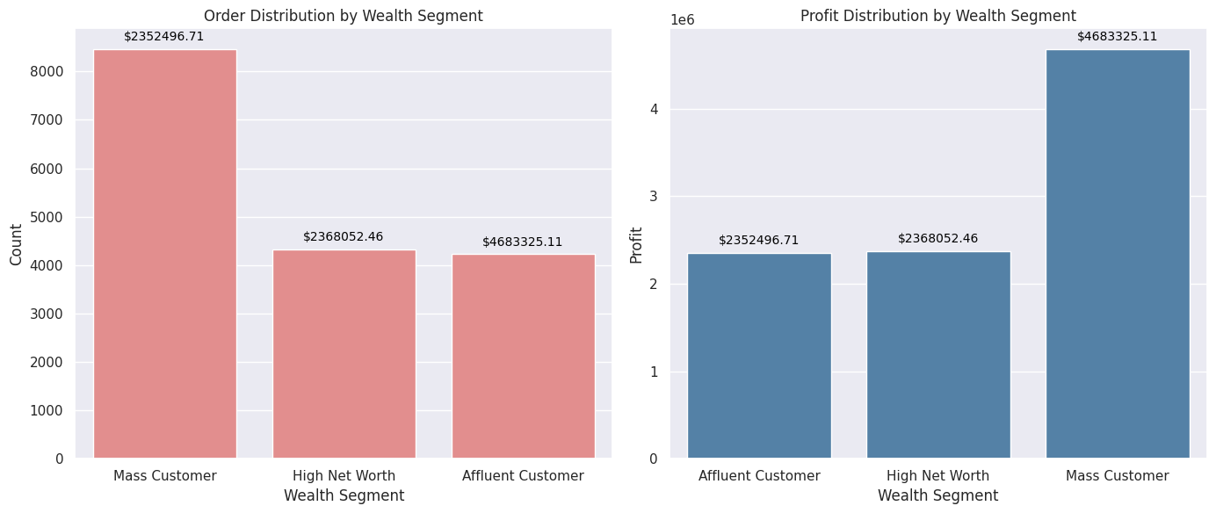
Note: The data and information in this document is reflective of a hypothetical situation and client. This document is to be used for KPMG Virtual Internship purposes only.
Data Exploration
Order and Profit Distribution by Wealth segment
Mass Customer shows the highest total Sum of Profit at $4,683325.11, followed by High Net Worth at $2368052.46 and Affluent Customer at $2352496.71.﻿﻿

Slide 6
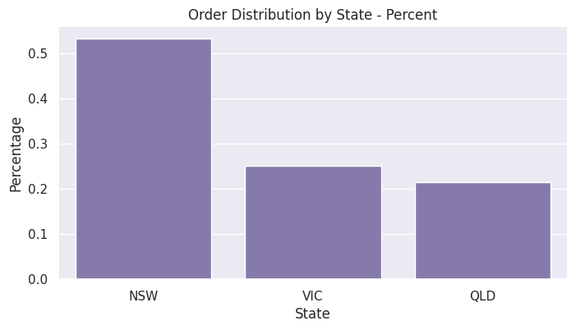
Note: The data and information in this document is reflective of a hypothetical situation and client. This document is to be used for KPMG Virtual Internship purposes only.
Data Exploration
Order Distribution according to the States
The State New South Wales has the highest order of 53.294152 and Victoria has 25.160153.

Slide 7
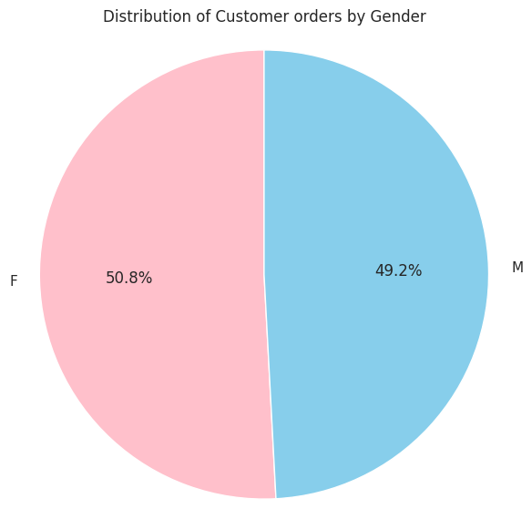
Note: The data and information in this document is reflective of a hypothetical situation and client. This document is to be used for KPMG Virtual Internship purposes only.
Data Exploration
Distribution of Customer orders according to the Gender.
Female forms the 50.8% of the market whereas Male forms 49.2%.
The target audience for our marketing and advertising should be inclined to provide focus on females than males

Slide 8
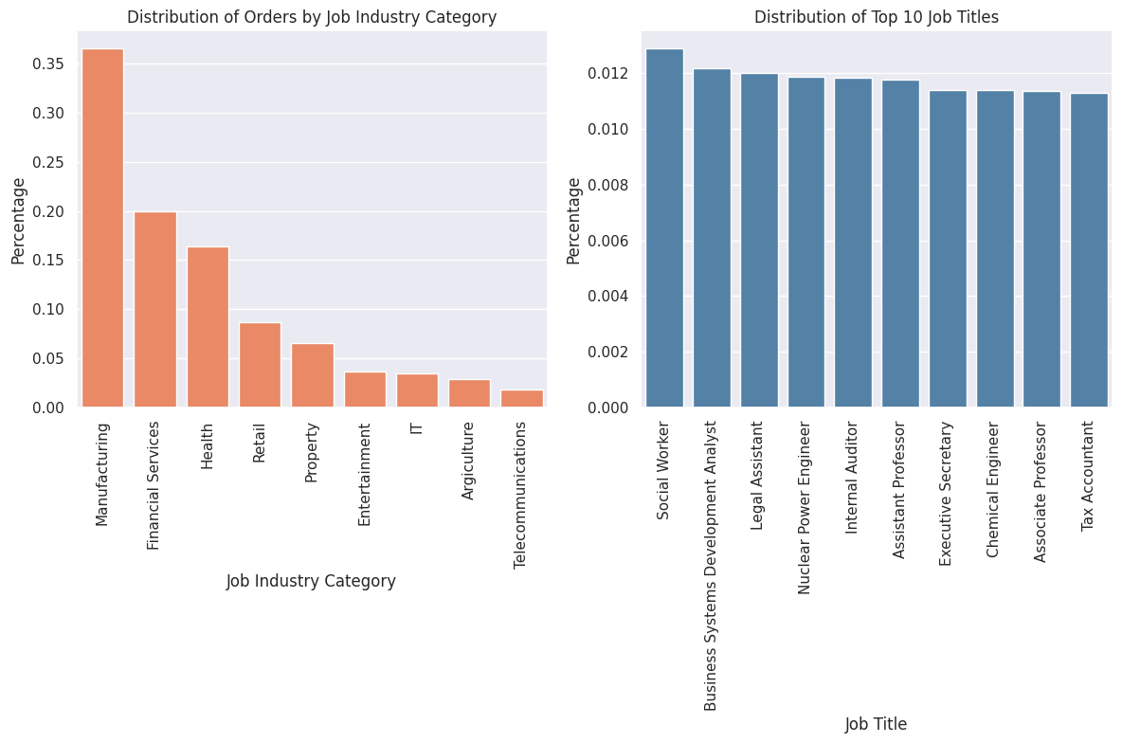
Note: The data and information in this document is reflective of a hypothetical situation and client. This document is to be used for KPMG Virtual Internship purposes only.
Data Exploration
Order Distribution according to Job Industry and Job Title.
Manufacturing sector shows the highest
Distribution of orders.
Therefore, the Manufacturing sector, Financial Services sector and Health should be the focus.
In the distribution of Top 10 Job Titles Social Worker tops it, followed by Business Systems Development Analyst.

Slide 9
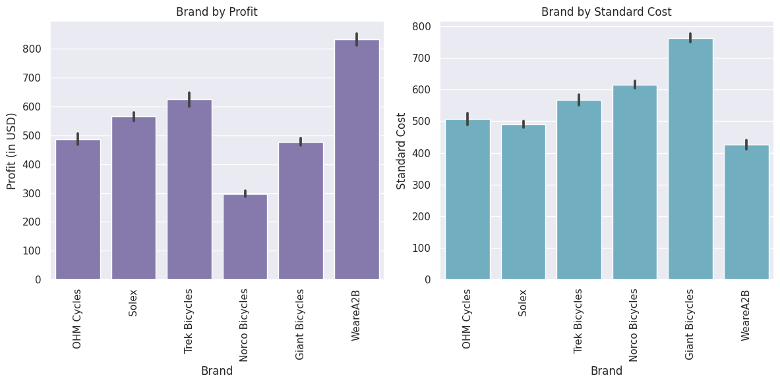
Note: The data and information in this document is reflective of a hypothetical situation and client. This document is to be used for KPMG Virtual Internship purposes only.
Data Exploration
Brand vs Profit and Brand vs Standard Cost
The Brand WeareA2B makes the most profit with the lowest standard cost.

Slide 10
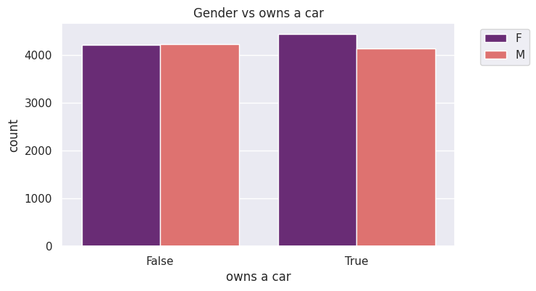
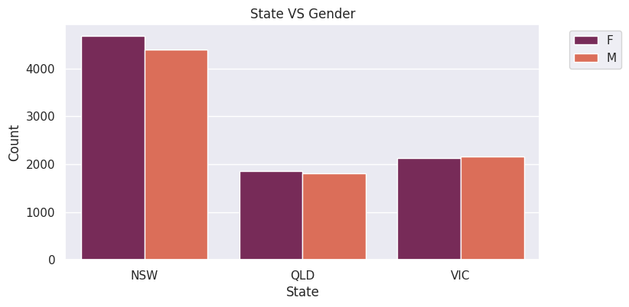
Note: The data and information in this document is reflective of a hypothetical situation and client. This document is to be used for KPMG Virtual Internship purposes only.
Data Exploration
Gender vs Owns Car and State vs Gender
Greater number of Females who owns a car buys bikes.
Greater number of Males who does not owns
^{a car buys bikes.}
New South Wales has the highest count of customers.
Females customers are more than males.

Slide 11
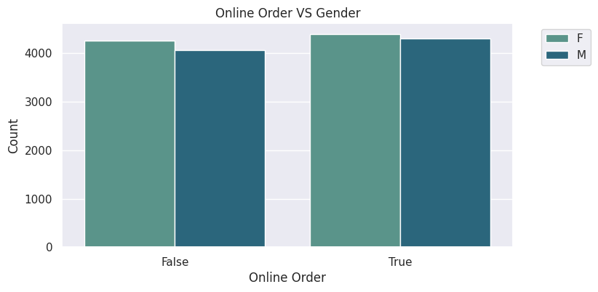
Note: The data and information in this document is reflective of a hypothetical situation and client. This document is to be used for KPMG Virtual Internship purposes only.
Data Exploration
Online Order vs Gender
Females buys bikes online more than Males do.

Slide 12
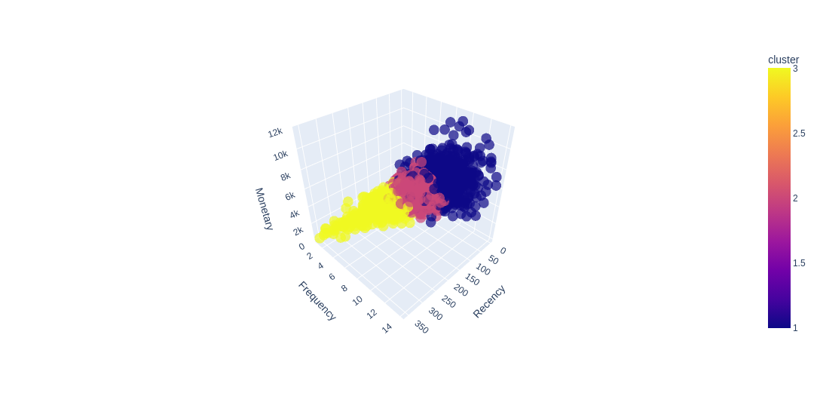
Note: The data and information in this document is reflective of a hypothetical situation and client. This document is to be used for KPMG Virtual Internship purposes only.
Model Development
Customer Segmentation using RFM Analysis.
RFM stands for Recency, Frequency and Monetary value,
Each value signifies key features of the customers.
RFM metrics are indicators of customers behavioural pattern
Because customer’s lifetime value is affected by the frequency and monetary value. The retention and measurement of engagement is affected by the recency value.
Recency denotes the freshness of customer’s activity, it can be in the form of purchase or simply a visit to the store. It signifies how much a customer is engaged with the product.
Frequency denotes the total number of transactions or average time engaged between transaction and visits.
Monetary denotes the intention of a customer to spend or purchase a product that is the “purchasing power of the customer”.

Slide 13
Note: The data and information in this document is reflective of a hypothetical situation and client. This document is to be used for KPMG Virtual Internship purposes only.
Model Development
Customer Id and rfm_score
The rank of the customers is calculated by combining the individual R, F, and M rankings to get an aggregate value which is called RFM score. This score is the average of the individual R, F, and M scores obtained by giving weights to each attributes of RFM.

Slide 14
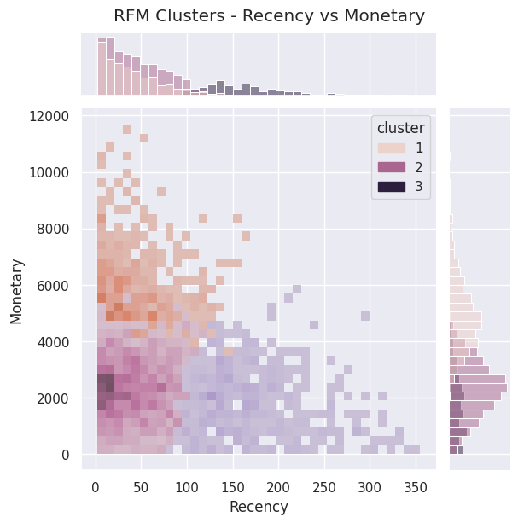
Note: The data and information in this document is reflective of a hypothetical situation and client. This document is to be used for KPMG Virtual Internship purposes only.
Model Development
Joint-plot based on Recency vs Monetary
The relationship between a potential customer and its engagement can be estimated by the customers who has purchased recently contributed higher monetary value.
Customers in the top-left of the joint-plot in cluster2 denotes
greater recency value and greater monetary value which combines to form potential customers who are active and purchases high value products. Business and marketing heads should concentrate on engaging and retaining them.
Customers in the top-right of the joint-plot in cluster1 denotes lower recency value with greater monetary value.
This shows the customers at risk who spent a significant amount in the past but did not made any transaction recently.

Slide 15
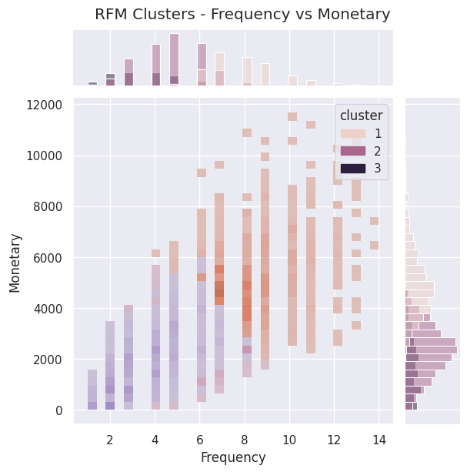
Note: The data and information in this document is reflective of a hypothetical situation and client. This document is to be used for KPMG Virtual Internship purposes only.
Model Development
Joint-plot based on Frequency vs Monetary
Customers who purchases frequently tend to spend more and hence contribute to higher monetary value.
In the joint-plot the customers in cluster 1 in the top-right position are the potential customers who spend a large amount of money frequently. Businesses and marketing heads should focus on nurturing relation with them.
In the top-right of the joint-plot are the customers that spends significantly but are low in numbers. So, they should be targeted to increase the sales by cross-selling.

Slide 16
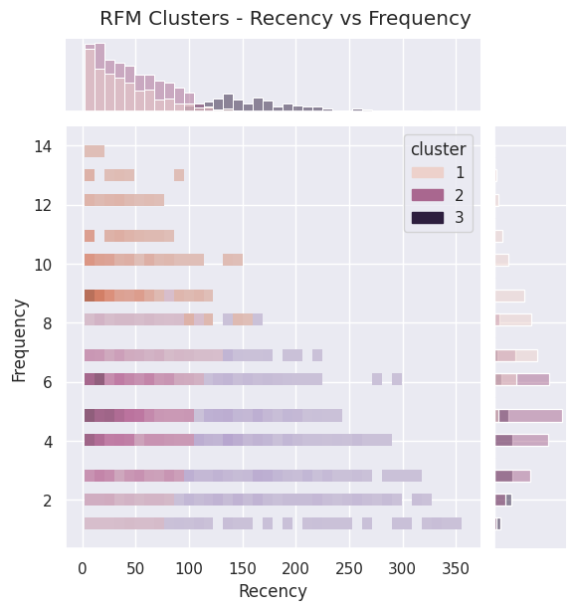
Note: The data and information in this document is reflective of a hypothetical situation and client. This document is to be used for KPMG Virtual Internship purposes only.
Model Development
Joint-plot based on Recency vs Frequency
In the joint-plot, the top-left position denotes high frequency and high recency with customers who are active and engaged.
The transaction made by these customers are recent and frequent.
In the joint-plot, the bottom-left position denotes low frequency customers who made transactions recently who represent new customers. Business and marketing heads should focus on nurturing the relationship with them and encourage their number of purchases by increasing their engagement.

Slide 17
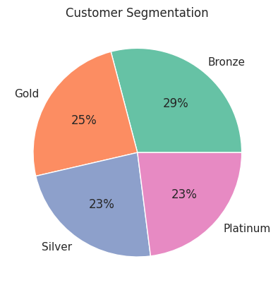
Note: The data and information in this document is reflective of a hypothetical situation and client. This document is to be used for KPMG Virtual Internship purposes only.
Model Development
Customer Segmentation in the dataset
The customer profile column is created by creating the Customer profile ranking. These ranks include Bronze, Silver, Gold and Platinum.

Slide 18
Note: The data and information in this document is reflective of a hypothetical situation and client. This document is to be used for KPMG Virtual Internship purposes only.
Model Development
Customer Segmentation – Target Potential Customers
In the new customer list, following customers should be focused :
Customers in the age-group 31-50.
Mass customers in the wealth segment.
Most of the high value customers are females compared to males.
Customers working in manufacturing, financial services and health sector.
Customers living in the New South Wales and Victoria.

Slide 19
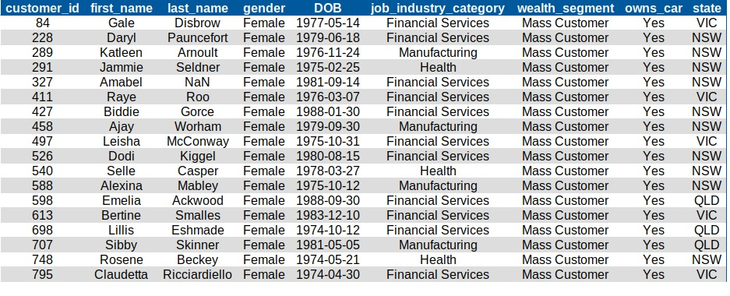
Note: The data and information in this document is reflective of a hypothetical situation and client. This document is to be used for KPMG Virtual Internship purposes only.
Interpretation
Potential Customers to target from the New Customers
List Dataset.

Slide 20
Note: The data and information in this document is reflective of a hypothetical situation and client. This document is to be used for KPMG Virtual Internship purposes only.
Thank you.

